Slide 1

End-to-end application for multispectral image captions
Wajih Ounis
Ahmedou Mohamed Elboukhary
3A INFO1
3A INFO1

Slide 2
Table of contents
Introduction
Technologies used
Design
Demo

Slide 3

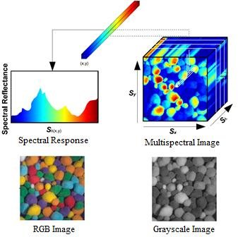
Introduction :
This project is built with the goal of generating captions for multispectral images.

Slide 4

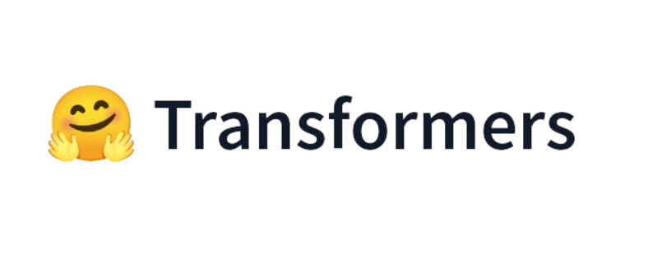



Technologies used

Slide 5

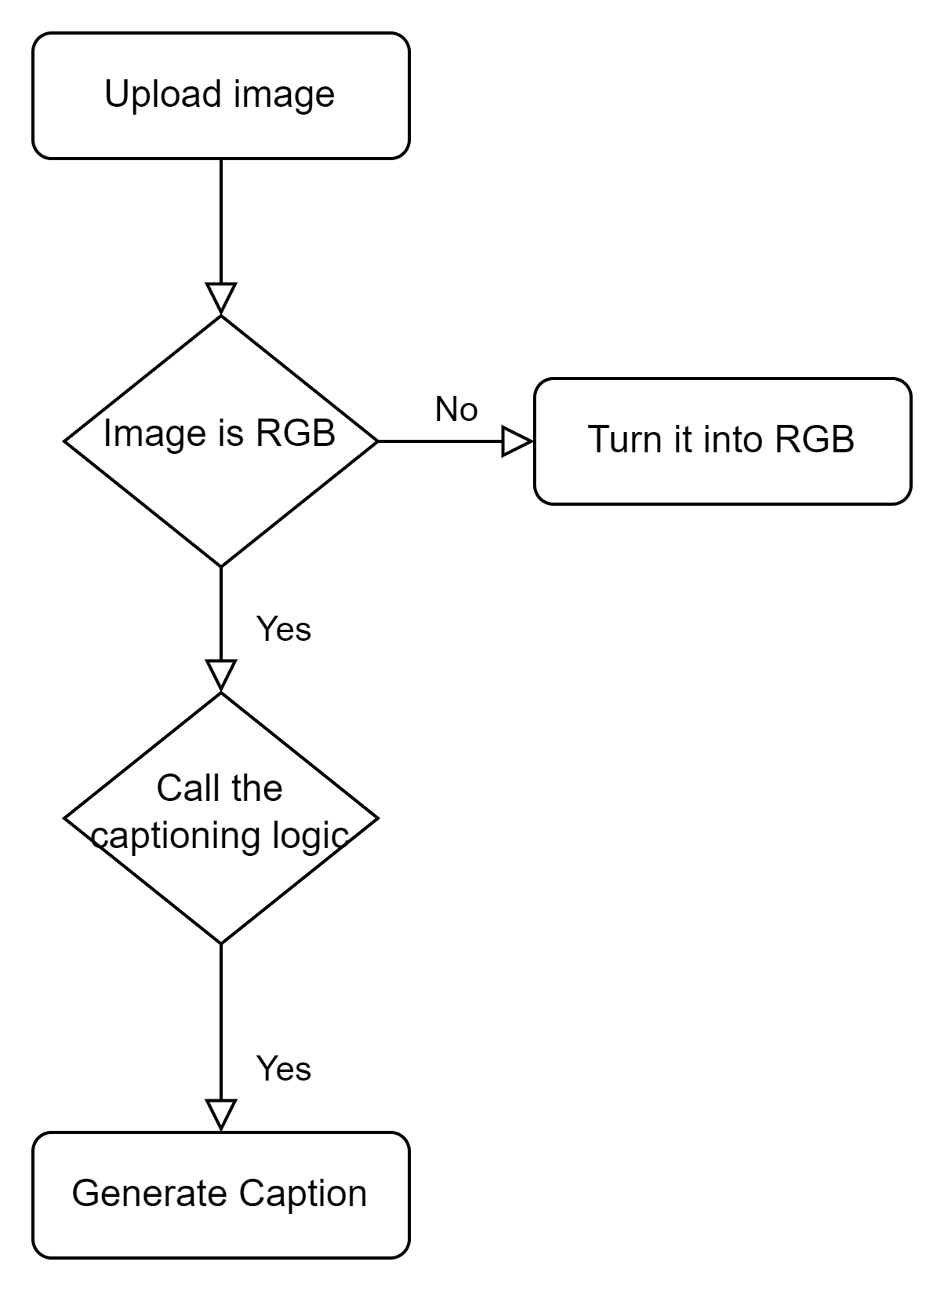
Design

Slide 6
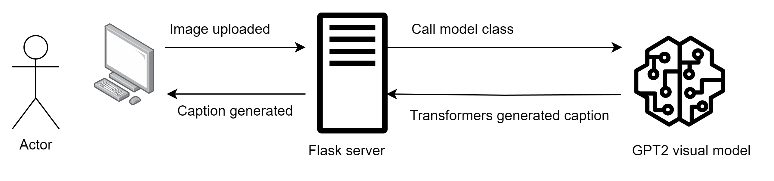
Design

Slide 7
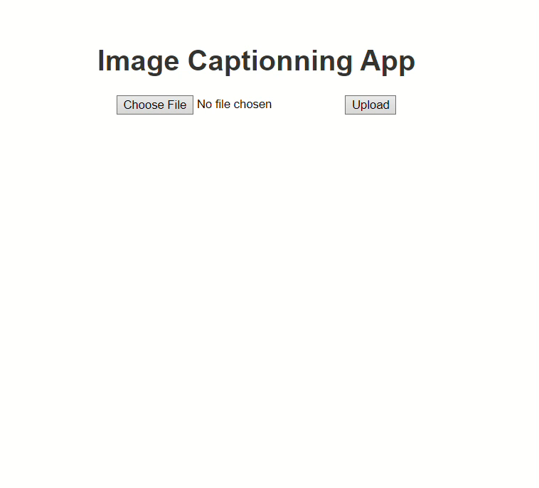
Demo

Slide 8
Thanks for your attention

